Slide 1
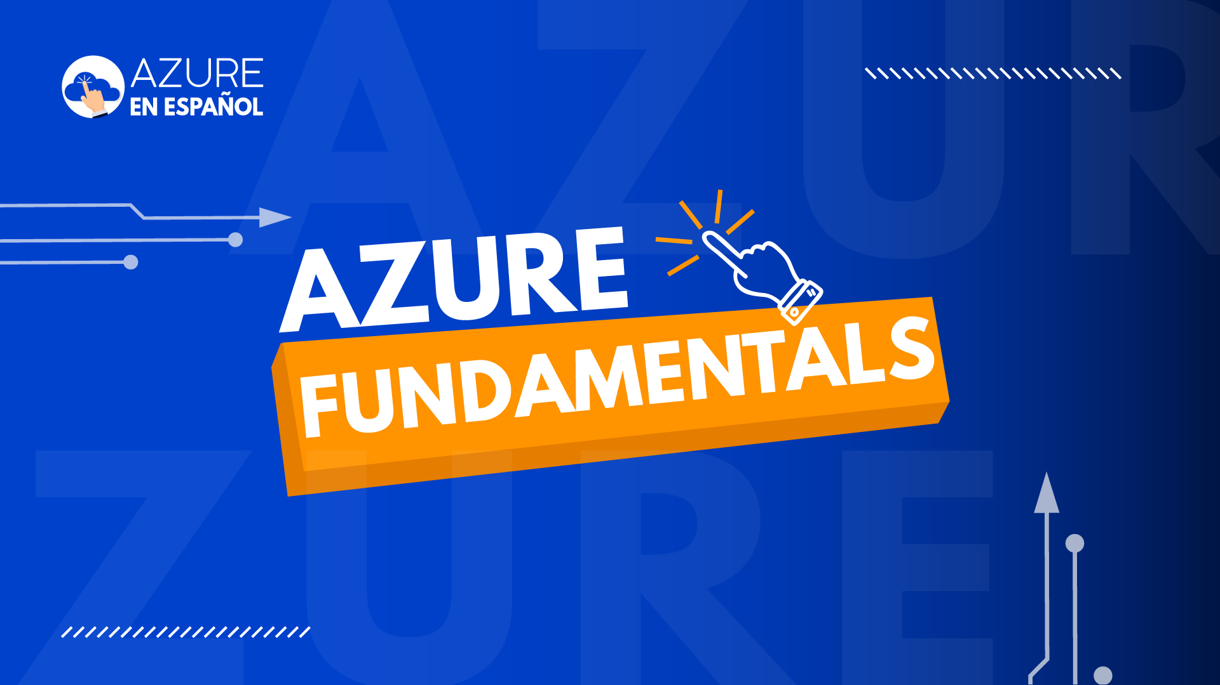

Slide 2
Preparación del Módulo
Describe Cloud Concepts (20-25%)

Slide 3
Describe Cloud Concepts (20-25%)
Identify the benefits and considerations of using cloud services:
Identify the benefits of cloud computing, such as High Availability, Scalability, Elasticity, Agility, and Disaster Recovery.
Identify the differences between Capital Expenditure (CapEx) and Operational Expenditure (OpEx).
Describe the consumption-based model.
Describe the differences between categories of cloud services:
Describe the shared responsibility model.
Describe Infrastructure-as-a-Service (IaaS).
Describe Platform-as-a-Service (PaaS).
Describe serverless computing.
Describe Software-as-a-Service (SaaS).
Identify a service type based on a use case.
Describe the differences between types of cloud computing:
Define cloud computing.
Describe Public cloud.
Describe Private cloud.
Describe Hybrid cloud.
Compare and contrast the three types of cloud computing.

